Slide 1
Speed part 4
Barb Ericson
Georgia Institute of Technology
May 2006

Slide 2
Learning Goals
Computing Concepts
  Understand what happens when Java is compiled and executed
  Explain the advantages of using a virtual machine
  Explain that some speed difference is due to the algorithm used to solve a problem
  Explain ways to compare algorithms
    Space
    Time

Slide 3
Java
Java was created to be interpreted
  When you compile Java code you create byte codes for a virtual machine
    One that doesn't necessarily exist
  When you run a main method in a class
    You are starting a Java Virtual Machine which interprets the virtual machine byte codes
  The goal is to write once in Java and run on any machine
    Without recompiling
Today, Java uses just-in-time compiling
  As the JVM runs it compiles the code to machine lang

Slide 4
A virtual machine that doesn't exist?
Machine language is a very simple language.
A program that interprets the machine language of some computer is not hard to write.
    def VMinterpret(program):
    for instruction in program:
    if instruction == 1: #It's a load
    ...
    if instruction == 2: #It's an add
    ...

Slide 5
Why use a Virtual Machine?
Can use the same code on many machines and devices
  From cell phones to appliances to large computers
Not locked into a processor type
  If you write code for a cell phone and the manufactures changes the processor
    You don't have to change or recompile the code
Can make the code safer
  Less apt to cause problems on the machine it is running on
    Like stop an out of bounds access of an array
Notes:
Microsoft adopted this approach with .NET.

Slide 6
How fast can we go?
Photoshop and Word are faster
  In part because they are compiled to machine language
  But, also because of the design of the algorithms they use
    Many different algorithms can be used to solve a problem
    Some algorithms take longer to execute than others
    Some algorithms won't finish executing in your lifetime
    Some can't even be written!

Slide 7
What is an algorithm?
A description of the steps to take in solving a problem
Many programs in different languages can implement the same algorithm
There is always more than one algorithm to solve any problem
Some computer scientist study algorithms
  And compare them
  And try to come up with better ones

Slide 8
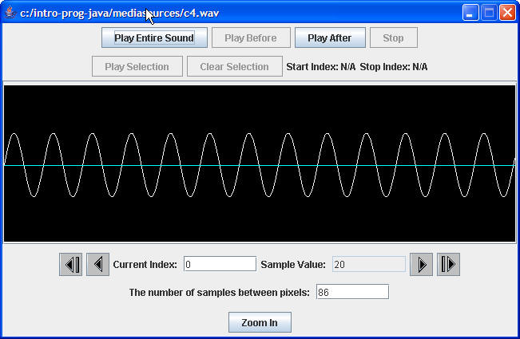
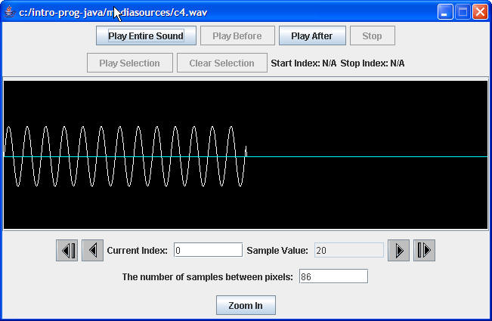
Programs implement Algorithms
We have seen several programs that implement the same algorithm
  We scaled a picture and a sound down by skipping every other value
  We blended two pictures and two sounds together
  We mirrored pictures and sounds

Slide 9
Comparing Algorithms
How do we decide which algorithm is better?
  We can compare the amount of space each takes
    What if an algorithm required us to keep every frame of a movie in memory at the same time?
  We can compare the amount of time each takes
    Not really execution time, but the magnitude of the number of steps (Big-Oh (O())

Slide 10
How Many Steps?
We count each declaration, assignment, and math expression as 1 step
We count the number of times a loop executes
  But the body of the loop as just 1 step
For nested loops we multiply
  the number of times the inner loop executes
  by the number of times the outer loop executes

Slide 11
How Many Steps?
What is the output from this code?
int count = 0;
for (int x = 0; x < 5; x++) {
for (int y = 0; y < 3; y++) {
count++;
System.out.println("Ran " + count +
" times with x=" + x + " and y=" + y);
}
}

Slide 12
Exercise
How many times will the following code print out the message?
String message = "I will be good";
for (int i = 1; i <= 5; i++) {
for (int j = 10; j > 0; j--) {
System.out.println(message ) ;
}
}

Slide 13
Big-Oh Notation
Really how much slower does the program get as the amount of data gets really big?
  If we have 2x the amount of data
    An O(n) algorithm will take twice as long
    An O(n²) algorithm will take four times as long
How do we determine the Big-Oh for an algorithm?
  Roughly the biggest factor in an expression of the number of steps

Slide 14
Big-Oh for Picture Programs
Any of the programs that processed all of the pixels of a picture is said to be O(n) where n is the number of pixels
  If we have twice as many pixels it would take twice as long to run
Any of the programs that processed all of the sound values in a sound is O(n) where n is the number of sound values
  If we have twice as many sound values it would take twice as long to run

Slide 15
Sorting Algorithms
Sort data into alphabetical or numerical order
  Bubble sort or insertion sort are O(n²)
    Sorting 100 elements can take 10,000 steps
  Quicksort is O(nlogn)
    Sorting 100 elements can take 460 steps
This kind of difference is important for businesses
  Create an index for a catalog of 100 elements

Slide 16
Exercise
Lookup how to do a bubble sort and write a method to sort an array of student names using bubble sort
Lookup how to do insertion sort and write a method to sort an array of student names using insertion sort
Lookup how to do quicksort and write a method to sort an array of student names using quicksort

Slide 17
Summary
Java programs compile to byte codes for a virtual machine
  One that doesn't necessarily exist
Virtual machines can be useful
  Code doesn't depend on the processor
  Can do safety checks
There are many different algorithms that can be used to solve a problem
  Some are better than others
We can compare two algorithms
  To see how much slower they get as the size of the data increases

